Slide 1
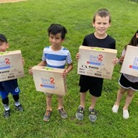
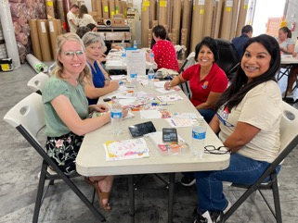
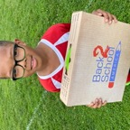
Phoenix Build-A-Kit
July 27, 2023
2023 Event Sponsorship
11/18/22

Slide 2
In 2022, so many families across the country continued to struggle. Most schools still lack adequate funds and too many parents can’t afford to buy even basic school supplies for their children. For the past 15 years, Back 2 School America has sent more than 340,000 needy kids back to school with the tools they need to succeed in the classroom. In 2023, our goal is to distribute more than 50,000 of our signature Back 2 School kits to help even more children — so we need your generous support!
Who do we reach?
We reach low-income families through a myriad of partnerships with schools, community organizations and government agencies. These include YMCAs, Operation Homefront (serving military families), New York City Coalition for the Homeless, Chicago’s Department of Family & Support Services (serving the homeless), Milwaukee Academy of Science, Phoenix Children’s Hospital, Heartland Alliance, YWCAs, United African Organization, Neighborhood Boys & Girls Clubs, Navajo Nation and many others.
Free school supply initiative
Our Back 2 School program is a year-round initiative to provide children with school supplies in the form of grade appropriate Back 2 School kits. Each kit contains approximately 30 vital school supplies. The bulk of our kits are given out during a series of distribution events. Our kits have a positive effect on a child’s classroom performance as well as their self-esteem. Our program also reduces the financial burden on parents, as well as teachers, who often reach into their own pockets to pay for school supplies for their students. By becoming a sponsor, you and your company will not only be helping a very worthwhile cause but will also receive positive exposure as well. We hope you will consider joining our program or continue your support as a sponsor. Tens of millions of children in the USA come from families that can’t afford to buy even basic school supplies. We have a long way to go, but TOGETHER, we can MAKE it happen.

Slide 3
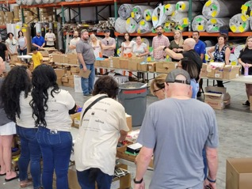
Event Day Elements
Date: July 27, 2023 Time: 3:00 pm – 9:00 pm Location:
InteriorWorx Commercial Flooring 2040 W. Rio Salado Pkwy, Tempe, AZ 85281
Details:
Assemble Back 2 School kits
Write “Notes of Inspiration”
Kits will be distributed to children from low-income families in Arizona
Food and beverages provided
Each volunteer receives a custom event t-shirt

Slide 4
Phoenix Build-A-Kit Event Sponsorship Levels and Benefits
Sponsorship Level | Platinum | Diamond | Gold | Silver | Bronze
Amount: | $25,000 | $10,000 | $5,000 | $2,500 | $1,000
Logo on Event Kit Box and Carton | X-Large | Medium | Small | Type Only
Featured on Event Banner Logo | Large | Medium | Small | X- Small | Type Only
Featured on Event T-Shirt | Large | Medium | Small | X-Small | Type Only
Website Presence with Logo | Large | Medium | Small | X-Small | Type Only
Social Media Mentions | 4 | 3 | 2 | 1 | 1
Mentioned in Newsletter Story | X | X
Listed as Sponsor on Press Release and Media Alert | X | X
Ability to Insert Company Materials into Kit | X | X
Ability to Select Organization to Receive Kits | X
Ability to Distribute Information at Event | X
Ability to Display Company Banner at Event | X
*To receive all benefits, sponsorship must be secured at least one month prior to the event date.

Slide 5
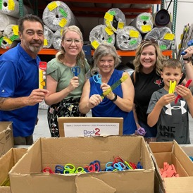
Back 2 School America
Since its inception, the Back 2 School program has provided over 10 million free school supplies to children of low-income households, lessening the financial burden on their families.
With your support, Back 2 School America can continue to help level the playing field and make sure that all children have the opportunity to get a first-rate education and go on to become healthy, happy, productive members of our society.
For more information on sponsorship, please contact CEO, Matthew Kurtzman 312.848.5551 or MatthewKurtzman@b2sa.org
Back 2 School America’s mission is to create and support educational opportunities that enrich the lives of children across the USA.
Back 2 School America is a 501c3 nonprofit. EIN 27-2492956

